Slide 1
Data Visualization of Bird Strikes Between 2000 - 2011
ARIYA BHARADWAJ

Slide 2
Project Title | Data Visualization of Bird Strikes Between 2000 - 2011
Technologies | Data Science
Domain | Transportation and Communication
Project Difficulty Level | Intermediate
Programming Language Used | Python
Technologies Used | Jypyter Notebook, MS Excel

Slide 3
Table of contents
01
02
03
04
Problem Statement
Objective
Visual Analytics Dashboard
05
Key Performance Indicator
Conclusion

Slide 4
Problem Statement
Environmental impacts and safety in urban transport and aviation are critical concerns for the scientific community. Bird strikes, collisions between birds and aircraft, pose significant aviation safety threats, especially during take-off and landing. These incidents can cause severe aircraft damage and fatal accidents, requiring thorough analysis and preventive measures.

Slide 5
Objective
The objective is to address environmental and safety concerns in urban transport and aviation using technology and AI. Focusing on bird strikes, which threaten aviation safety, this study analyzes FAA data from 2000 to 2011. The goal is to develop preventive measures and distributed approaches using available technologies and multi-agent systems (MAS) to enhance transport safety.

Slide 6
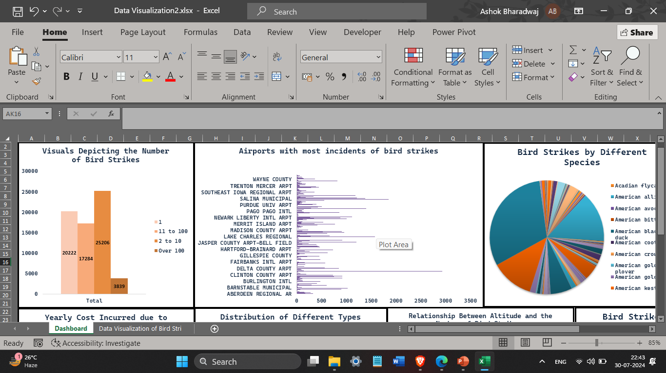
Visual Analytics Dashboard
Visual data shows that bird strike occurrences often lie between 2 and 10, which is notably high.
Delta County Airport experiences the highest number of bird strikes.

Slide 7


The American alligator suffers the highest mortality rate in bird strike incidents.
The cost incurred due to bird strikes in 2001 was significantly high.

Slide 8

The year 2009 experienced a significant spread of damages over time.
The occurrence of bird strikes increases with altitude, particularly beyond 1000 feet.

Slide 9
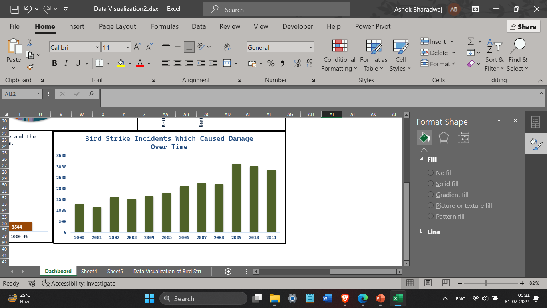

Bird strike damage was especially high during the year 2009.
The occurrence of bird strikes in British Columbia has grown over time.

Slide 10
Key Performance Indicator
Visuals Depicting the Number of Bird Strikes
Airports with most incidents of bird strikes
Bird Strikes of Different Species
Bird Strikes in Different States over Time
Yearly Cost Incurred due to Bird Strikes
Distribution of Different Types of Damage Over Time
Relationship Between Altitude and the Number of Bird Strikes.
Bird Strike Incidents Which Caused Damage Over Time

Slide 11
Conclusion
Visual data shows that bird strike occurrences often lie between 2 and 10, which is notably high.
Delta County Airport experiences the highest number of bird strikes.
The American alligator suffers the highest mortality rate in bird strike incidents.
The cost incurred due to bird strikes in 2001 was significantly high.
The year 2009 experienced a significant spread of damages over time.
The occurrence of bird strikes increases with altitude, particularly beyond 1000 feet.
Bird strike damage was especially high during the year 2009.
The occurrence of bird strikes in British Columbia has grown over time.

Slide 12
Thank You

